Slide 1
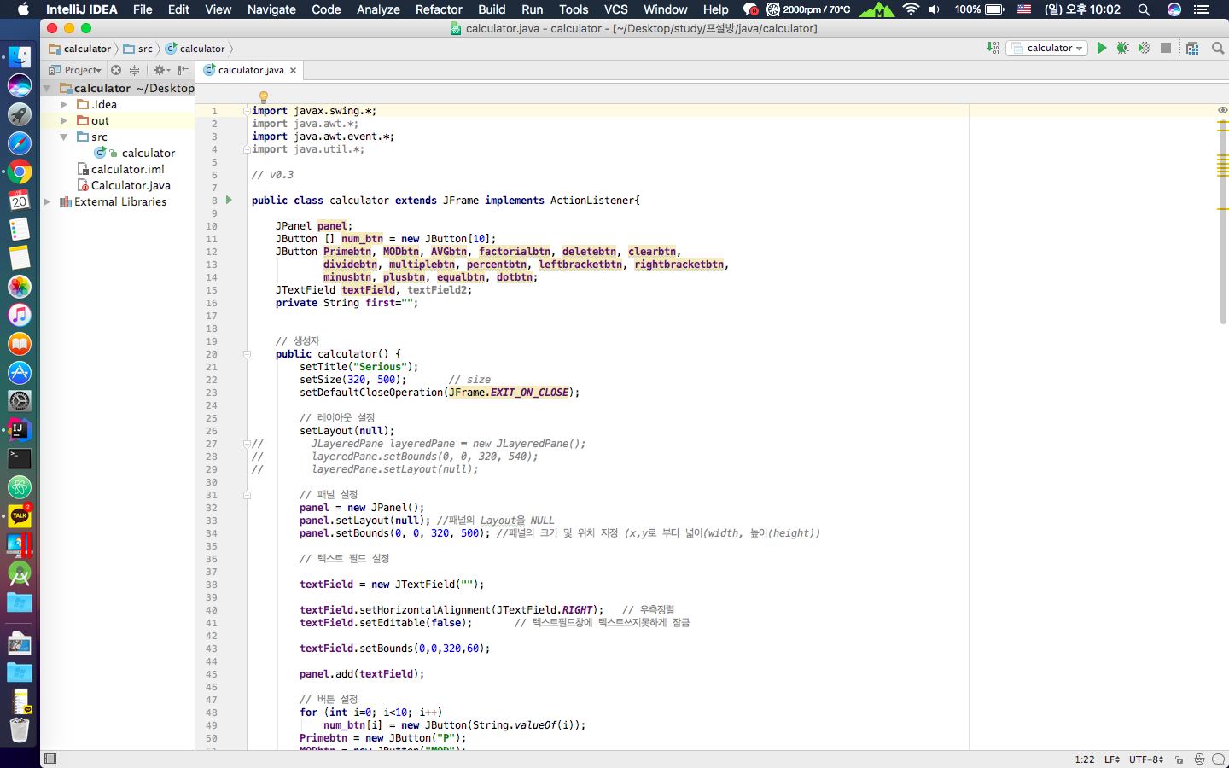
Open-Source SW
#28 - simpsons

Slide 2
Contents
Project
Serious
Others
Role
Github

Slide 3
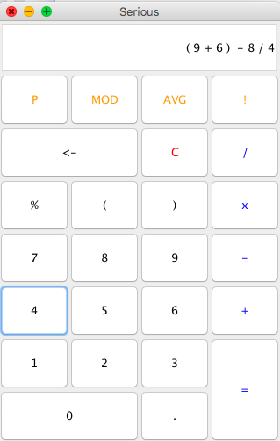
Project
Serious
Calculator -
JAVA Desktop App
License: GPL - 3.0

Slide 4
Role
Development
Translation
Reading
Design
Algorithm
Maintain
Documentation
Management
Park
Collaboration
Seo

Slide 5
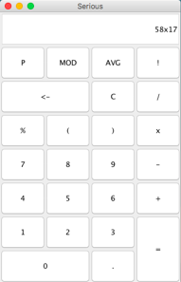
Serious – Old
Text field
Button
Set Location
Input function

Slide 6
Serious – New
KeyBoard Input
Delete Clear

Slide 7
Serious – New
Calculate
+, -, x, /, (, )

Slide 8
Serious – New
New Function

Slide 9
Serious – New
Secure Coding

Slide 10
Serious
CALCULATE
FUNCTION
0%
100%
GUI
BUG FIX

Slide 11
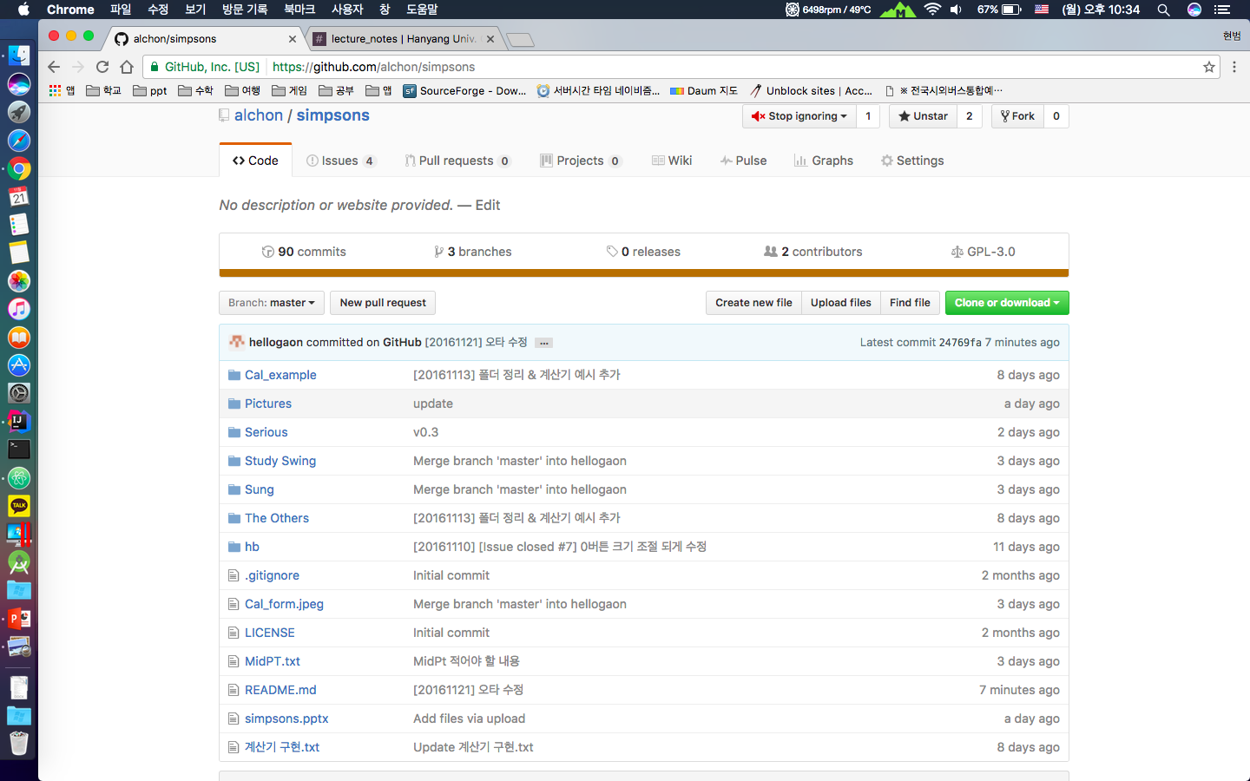
Github

Slide 12
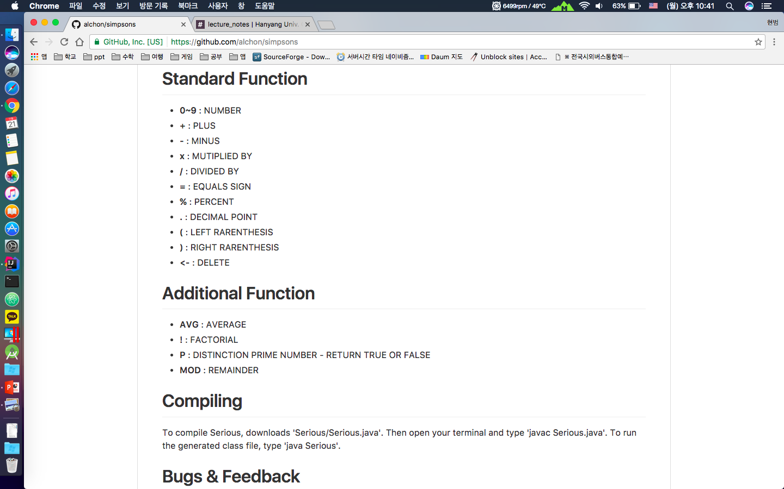
Github - README
Https://github.com/alchon/simpsons

Slide 13
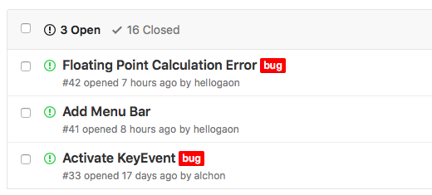
Github - ISSUE

Slide 14
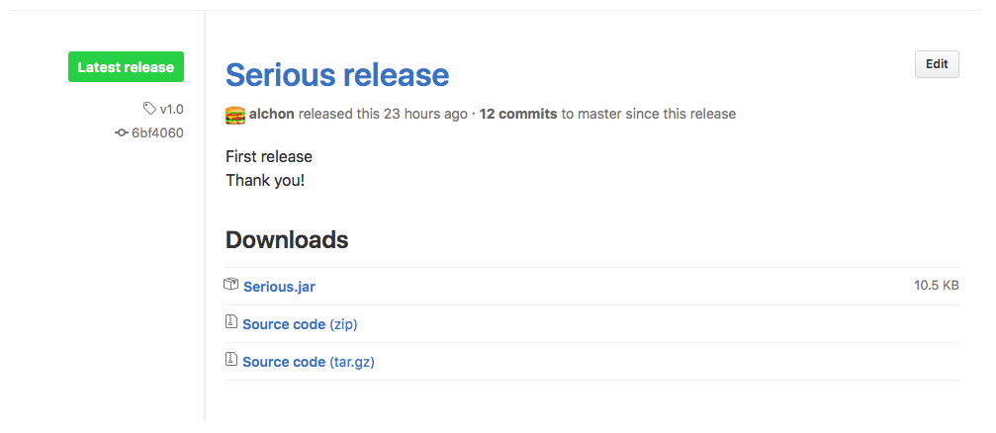
Serious – Release v1.0

Slide 15
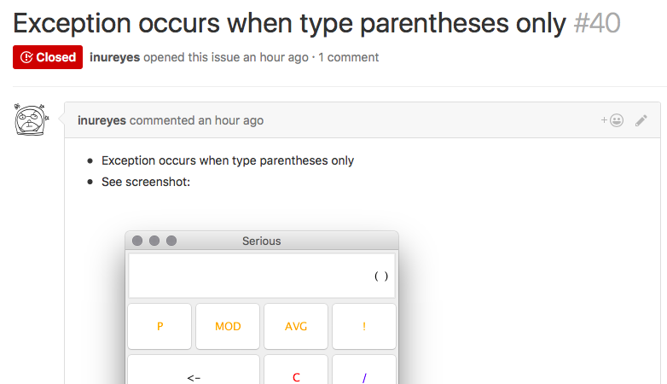
Serious – Issue Feedback

Slide 16
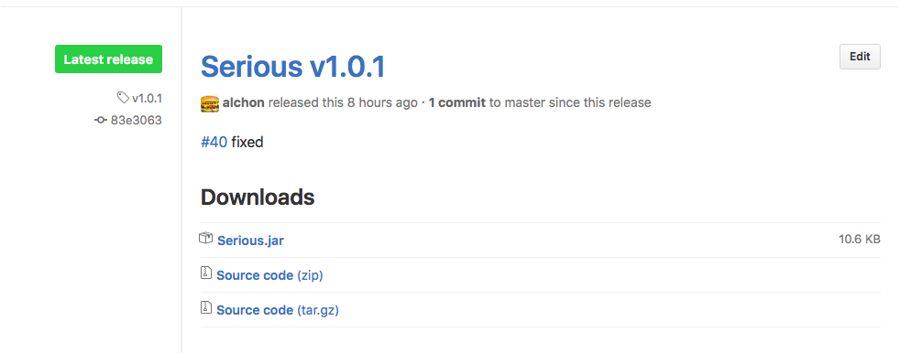
Serious – Release v1.0.1

Slide 17
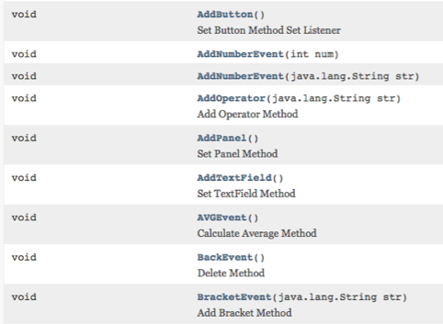
Serious – Java Doc

Slide 18
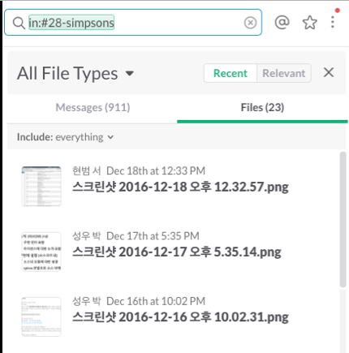
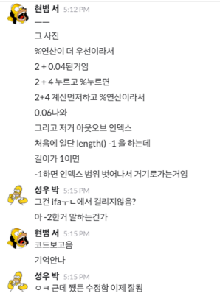
Serious – Slack

Slide 19
FEEDBACK

Slide 20
THANK YOU!

